Slide 1

YASMIN
(Yet Another Shared Memory for Intra-Node framework)
Efficient Intra-Node Communication Using Generic Sockets
Michalis Rozis, Stefanos Gerangelos, and Nectarios Koziris
National Technical University of Athens
Computing Systems, Laboratory

Slide 2
What’s the problem?
VMs exchange large amount of data. For example:
MapReduce workloads running in many VMs.
HPC applications
Network Function Virtualisation (NFV) such as routing, encryption, load balancing etc.
VMs access shared device (accelerators, crypto devices etc)
VMs can be placed in different nodes
Data path through NIC
VMs can be placed in the same node
Data path through memory bus
Memory speed > NIC

Slide 3
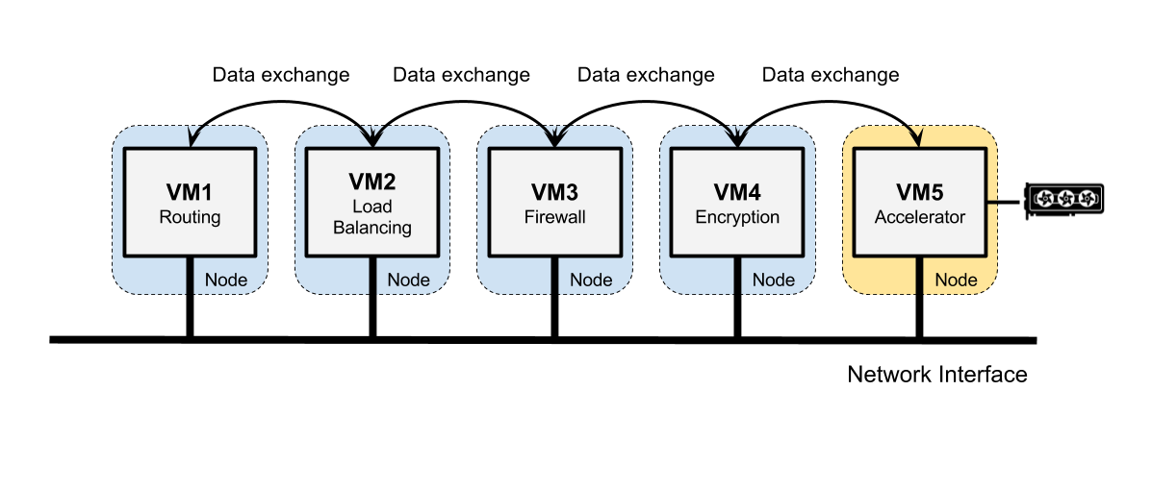
Example: NFV & shared device

Slide 4
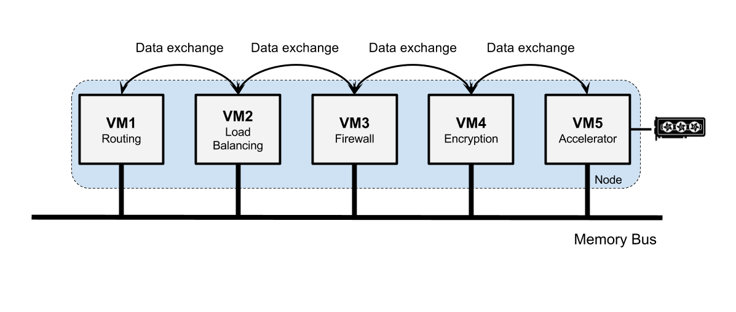
Example: Co-located VMs

Slide 5
Efficient Intra-node Communication
Place VMs in the same node
Make communication efficient (latency, throughput).
Applications need to be unaware of execution environment.

Slide 6
Build on the Xen hypervisor
Widely used
Lightweight type-1
PV Guests
Exploit page sharing techniques
Hypercalls: Special commands to the hypervisor
grant table: Shared pages between PV VMs
event-channel: Virtual interrupt mechanism

Slide 7
Standard intra-node communication:
Slow: Copies between VMs and control domain
Non - scalable:
Different applications between one pair: same interface
Different pair of VMs: all traffic through control domain.
✓Leave Control Domain alone.

Slide 8
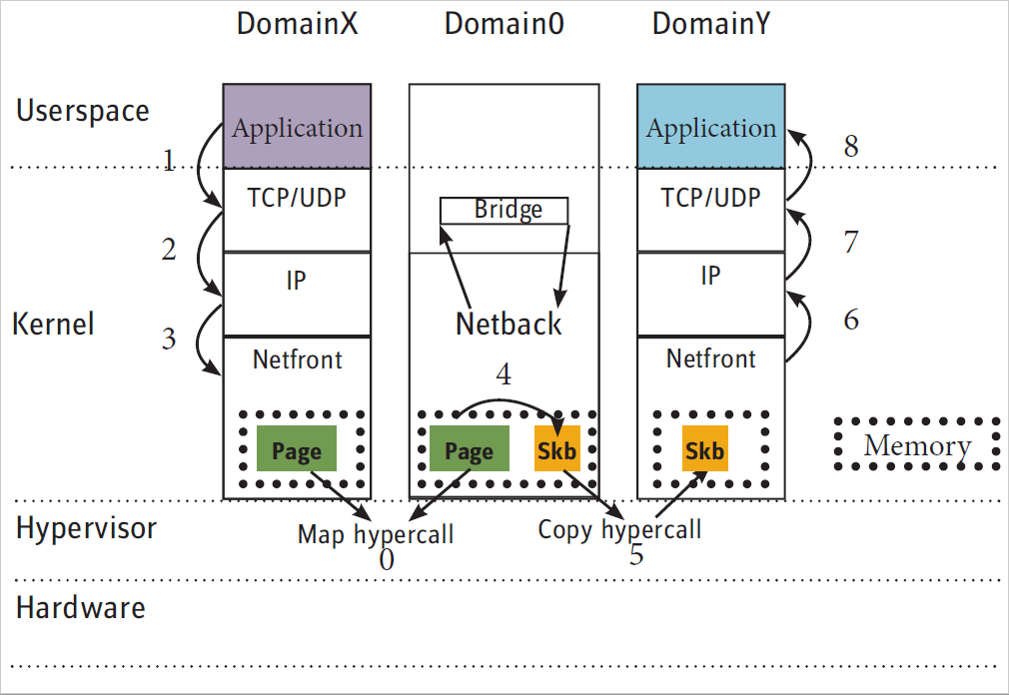
Xen netback / netfront

Slide 9

How?
Idea : Page Sharing between connecting VMs
Packet send/receive through network → copies to/from memory
Endpoints responsible for setup and breakdown of channel.
Sockets

Slide 10
Related work
Page sharing with Sockets connections
New Socket API
Hypervisor modification
Packet capture and process
Already tested. But...
Compatibility issues
Refactor code
Recompile
Protocol stack overhead

Slide 11
What’s new with YASMIN?
Compatibility very important
Wiseman said just stick to POSIX Sockets
Why always pay TCP/IP fee? Do we really need this? Take a shortcut!
Build a new protocol from scratch?
Use vSockets (AF_VSOCK) with a brand new transport layer

Slide 12
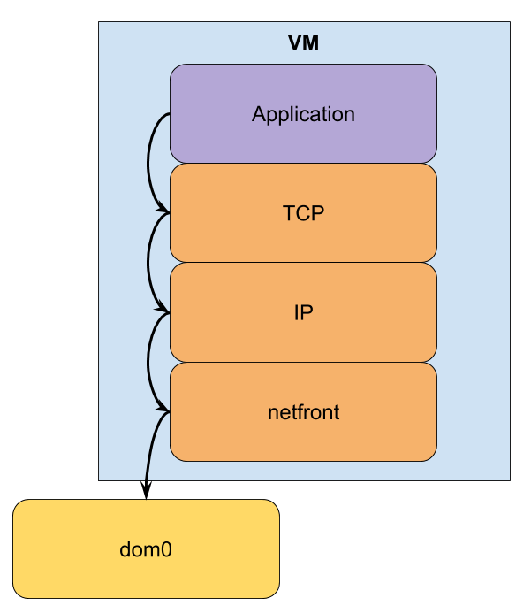
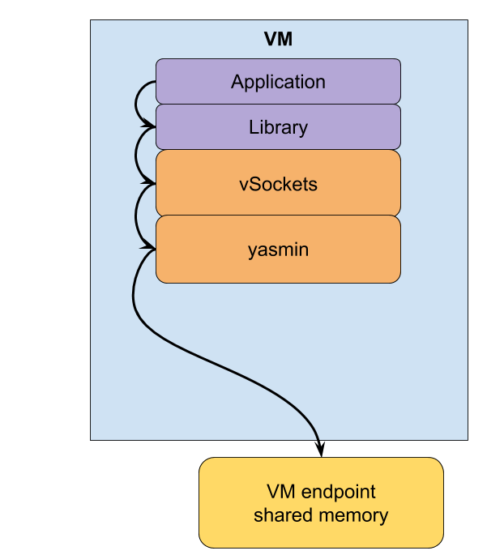
Design overview
Default
YASMIN

Slide 13
Details
TCP/IP socket calls translated to vSockets calls (AF_VSOCK)
hosts file with IPv4 - domID mappings
One control channel connecting VM pairs
One data channel for connecting socket pairs (persocket channel)

Slide 14
Channel setup
Grant-table mechanism for shared pages (grant access & map)
Event-channel for packet notification
Producer - consumer ring (no locks) in shared memory
memcpy_to/from_user() for actual data transfer

Slide 15
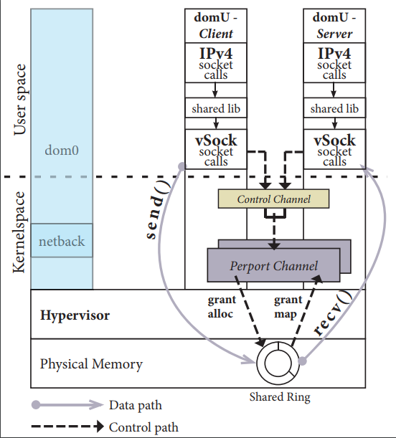

Slide 16
Evaluation
Use microbenchmarks (Iperf, NetPIPE, STREAM)
Latency
Bandwidth
Scaling

Slide 17
Baseline
Compare to:
netback / netfront
UNIX Sockets
Memory bandwidth

Slide 18
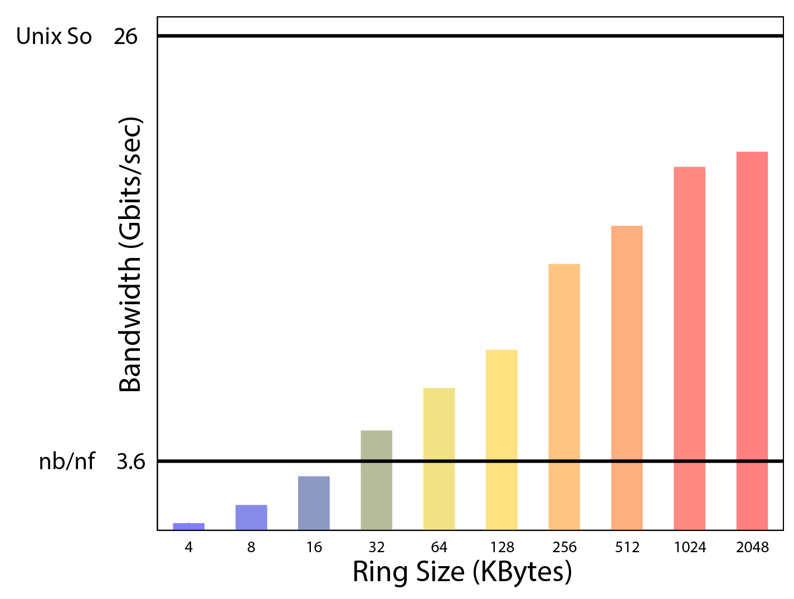
Proper Ring Size

Slide 19
Latency - throughput
For 512kB ring size (128 pages):
Latency reduction up to 65% (netback/netfront)
YASMIN @22μsec
netback/netfront @64μsec
Throughput increase by 4.4x (netback/netfront)
netback/netfront @ 463MBytes/sec
YASMIN @2048MBytes/sec
Memory@2813MBytes/sec
UNIX Sockets @3250MBytes/sec

Slide 20
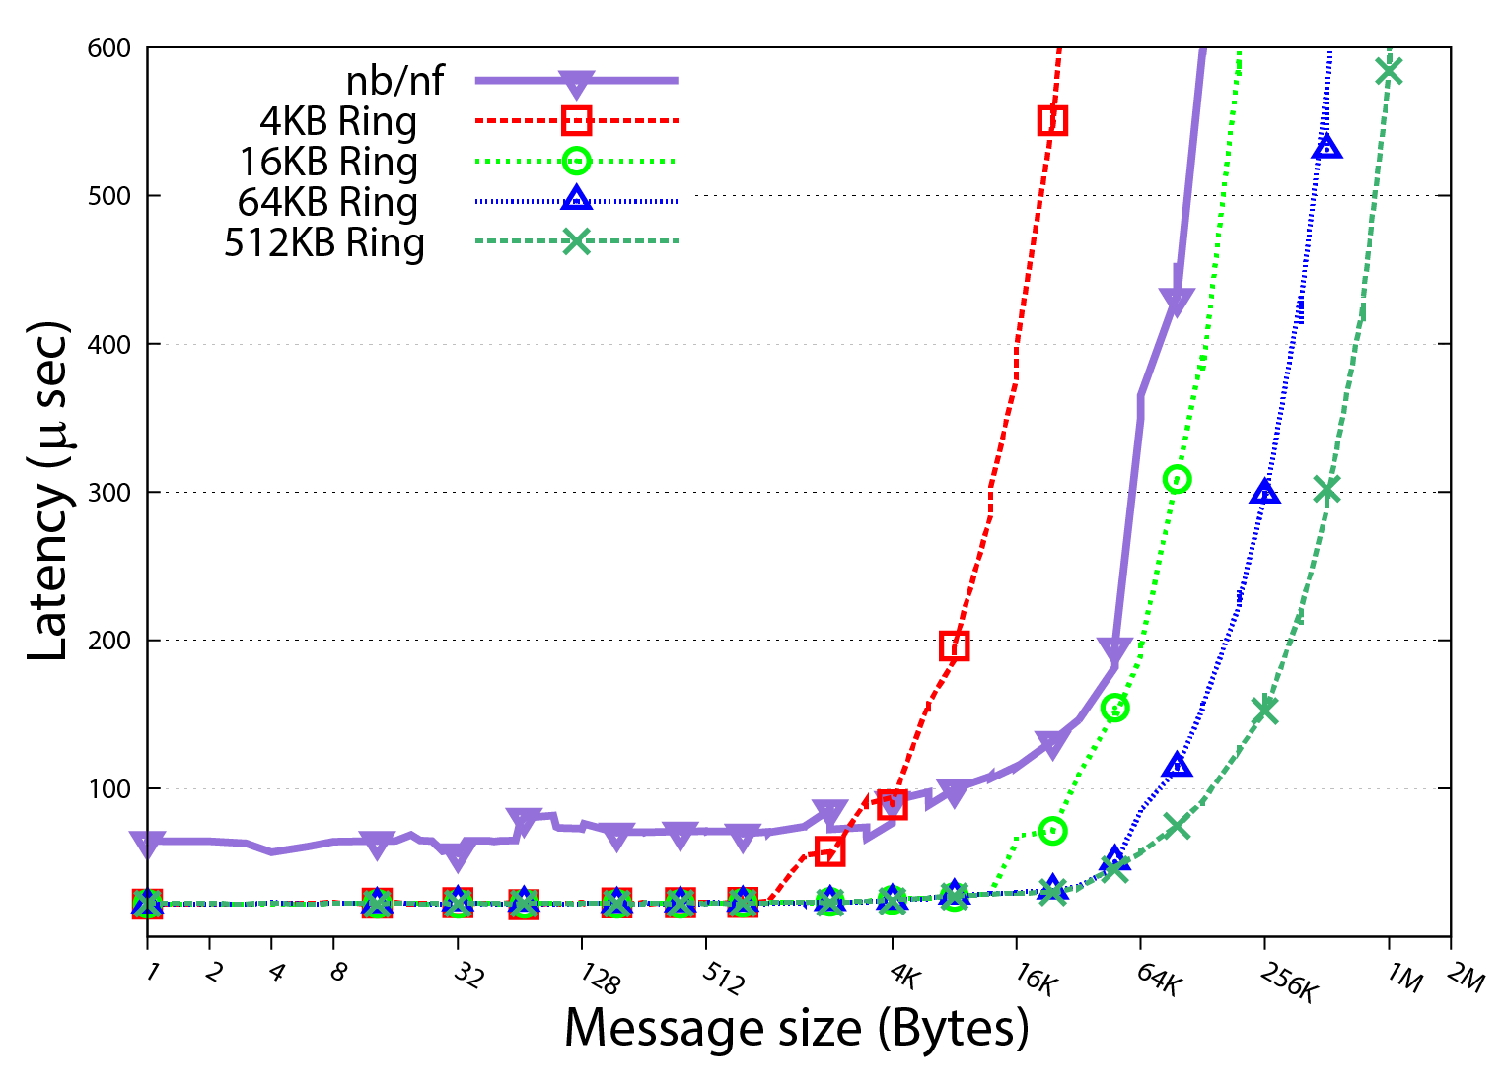

Slide 21
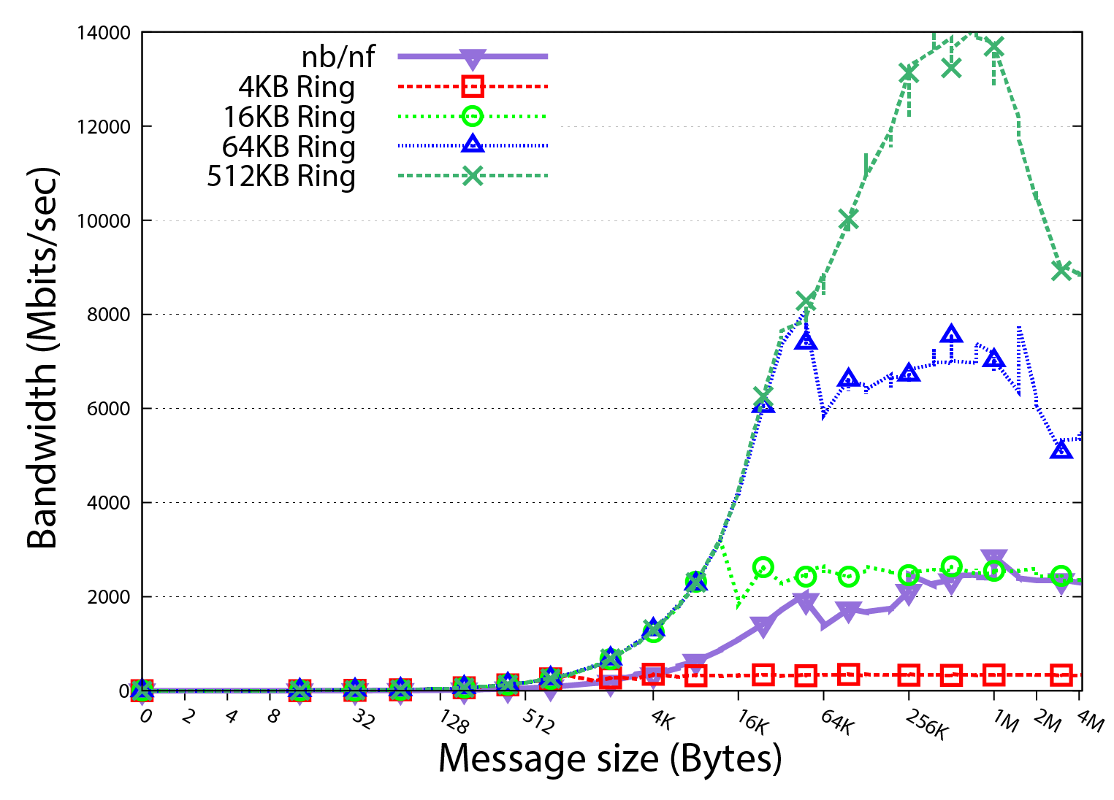

Slide 22
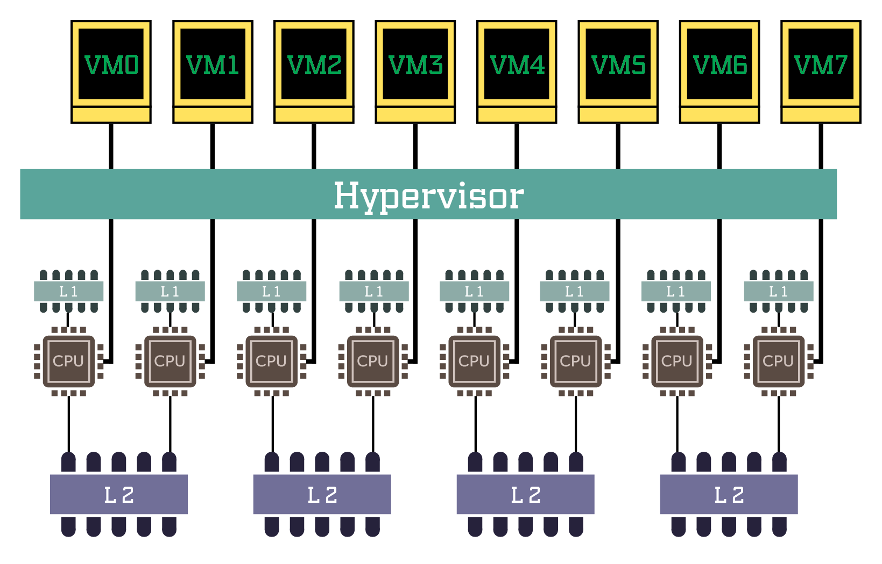
Scaling setup:

Slide 23
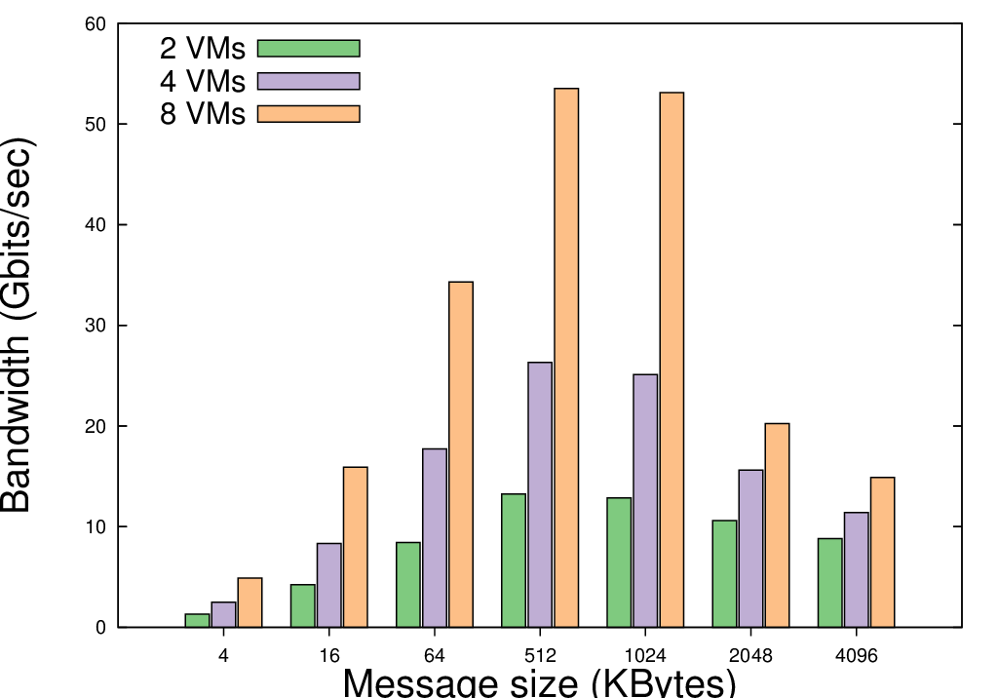

Slide 24
Conclusion
VMs exchange data → Run in same physical node
POSIX Sockets - Retain compatibility
No refactoring
No recompiling
No hypervisor modification
Choose transport layer on the fly
Exploit shared memory
Bypass TCP/IP
Latency - Throughput - Scaling

Slide 25
Future work
Test on real-life applications (NFV infrastructure)
Validate caching effects
Enhance hosts file mechanism

